Slide 1
Predicting Abalone Age Using Regression Models
Rakesh Kumar Busa, Jeremy Driscoll, Daniel Ackom

Slide 2

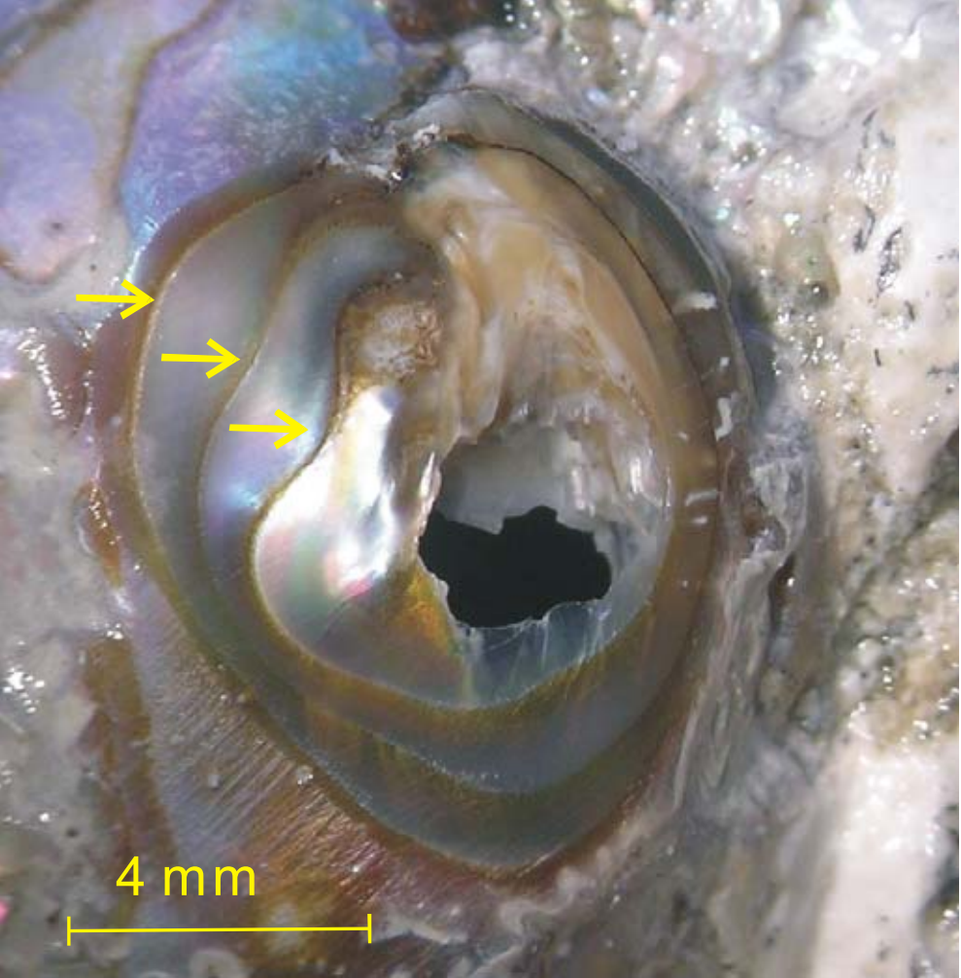
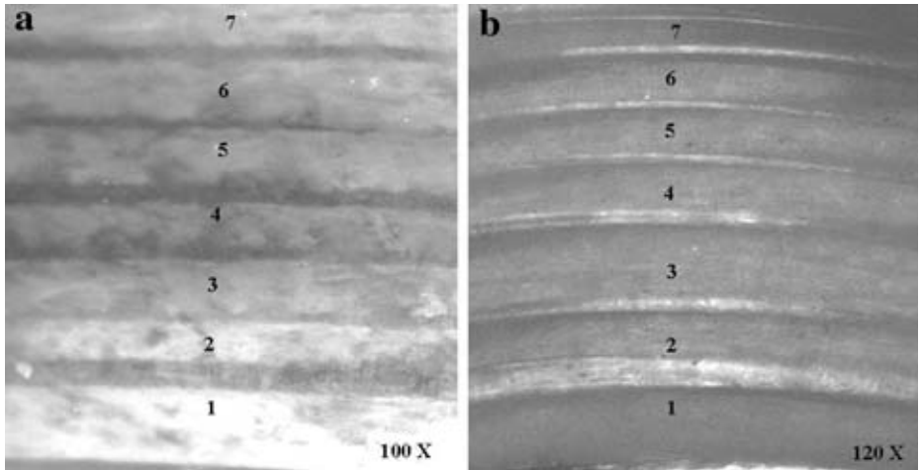
Introduction
Age determination in abalones is critical for:
Understanding growth patterns, population health, and ecosystem balance.
Informing sustainable fisheries management
Current Challenge
Traditional methods rely on manual counting of shell growth rings:
Labor-intensive and subjective.
High risk of human error
Figure 1: Abalone
Figure 2: Abalone shell under (a) fluorescent UV microscope and (b) stereo dissecting microscope (Wood 1993), with seven sets of rings visible
Figure 3: Magnified (about 12 ×) polished spire of abalone shell. Arrows indicate three growth checks

Slide 3
Introduction
Study Objective
To investigate the predictive capability of:
Linear regression
Ridge regression
Lasso
Polynomial
models to estimate abalone age based on physical attributes
Dataset
Source: University of California, Irvine (UCI) Machine Learning Repository
Observations: 4,177
Features: Length, diameter, height, sex, viscera weight, whole weight, shucked weight, etc.

Slide 4
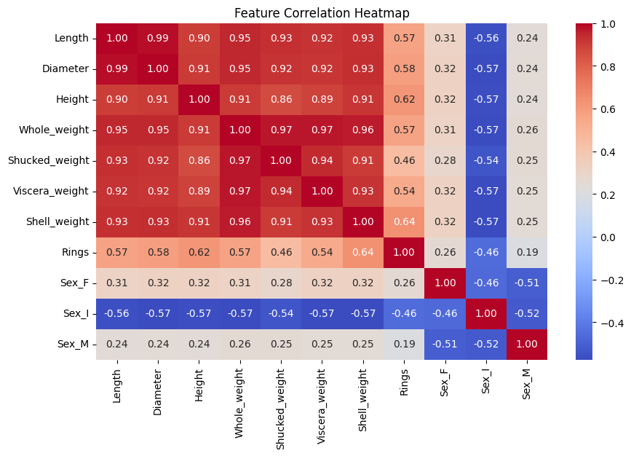
Data Processing
Figure 4: Heatmap

Slide 5
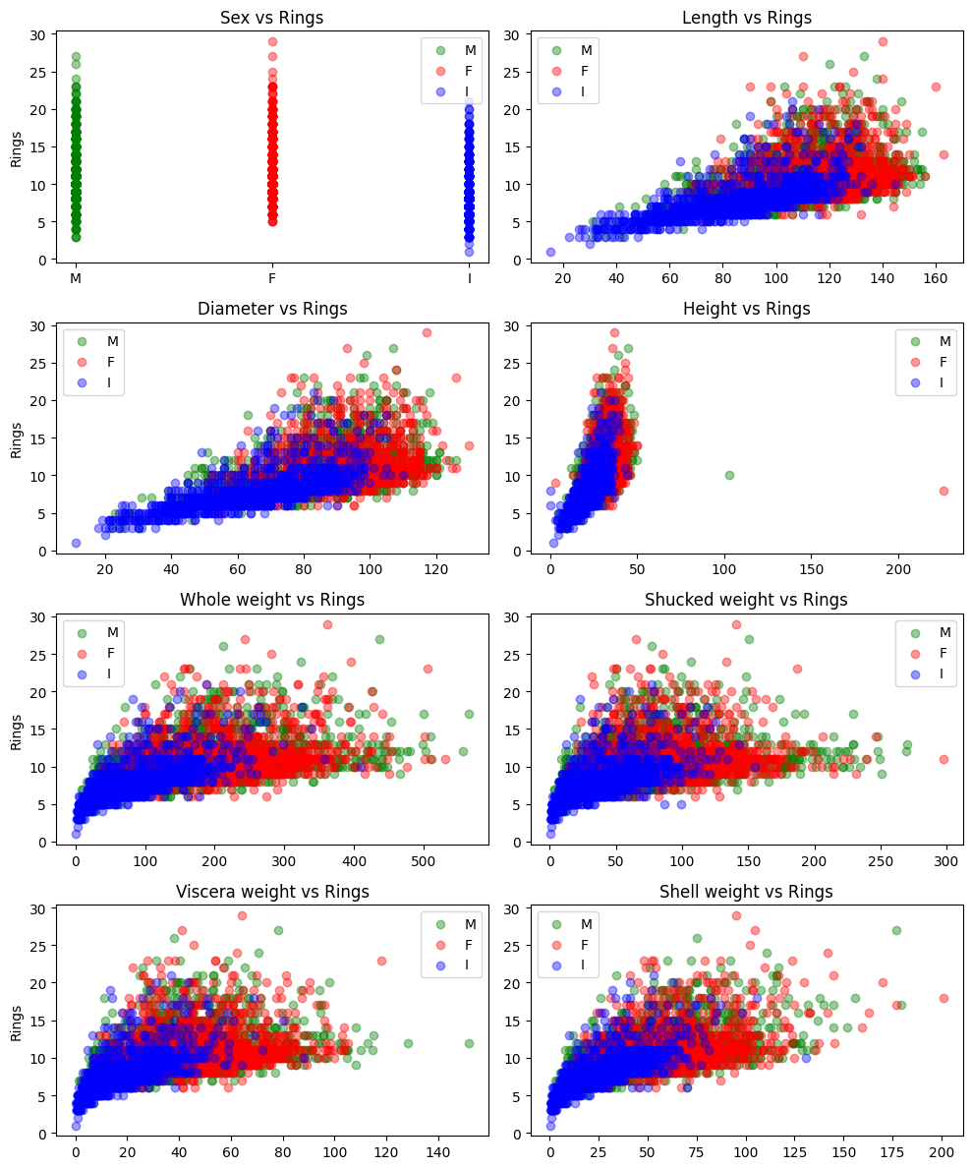
Data Processing
Figure 5: Relationship between target variable (rings) and different features

Slide 6
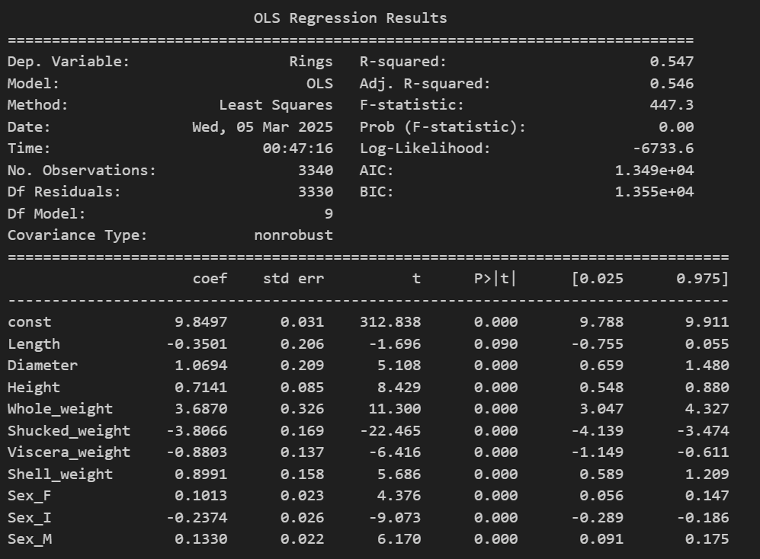
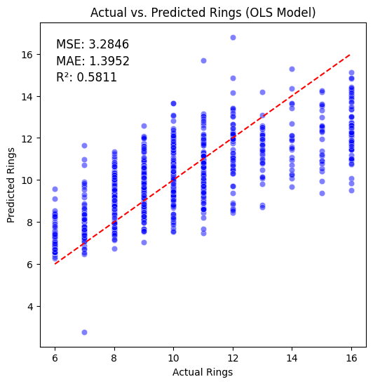
Model Fitting and Evaluation - OLS
Figure 6: Performance of OLS model

Slide 7
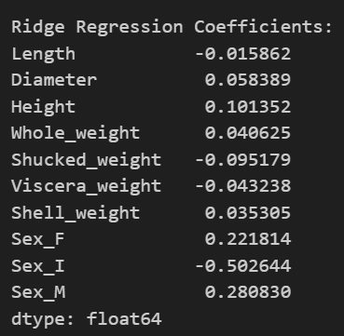
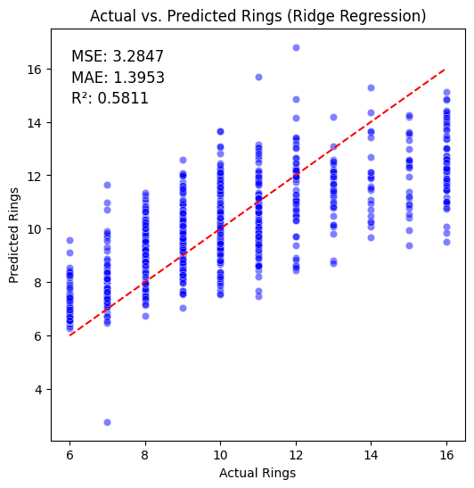
Model Fitting and Evaluation - Ridge
Figure 7: Performance of Ridge Regression

Slide 8
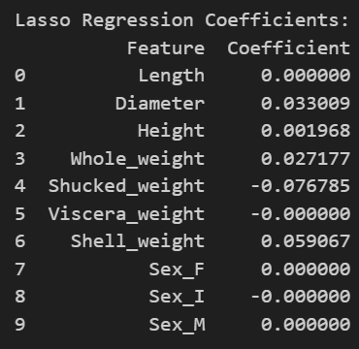
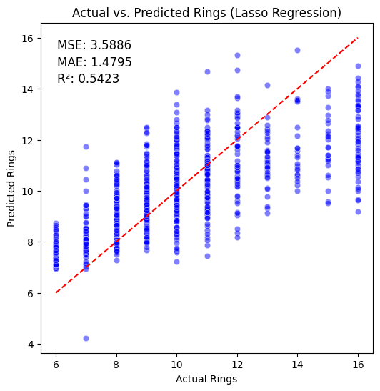
Model Fitting and Evaluation - LASSO
Figure 8: Performance of LASSO Regression

Slide 9
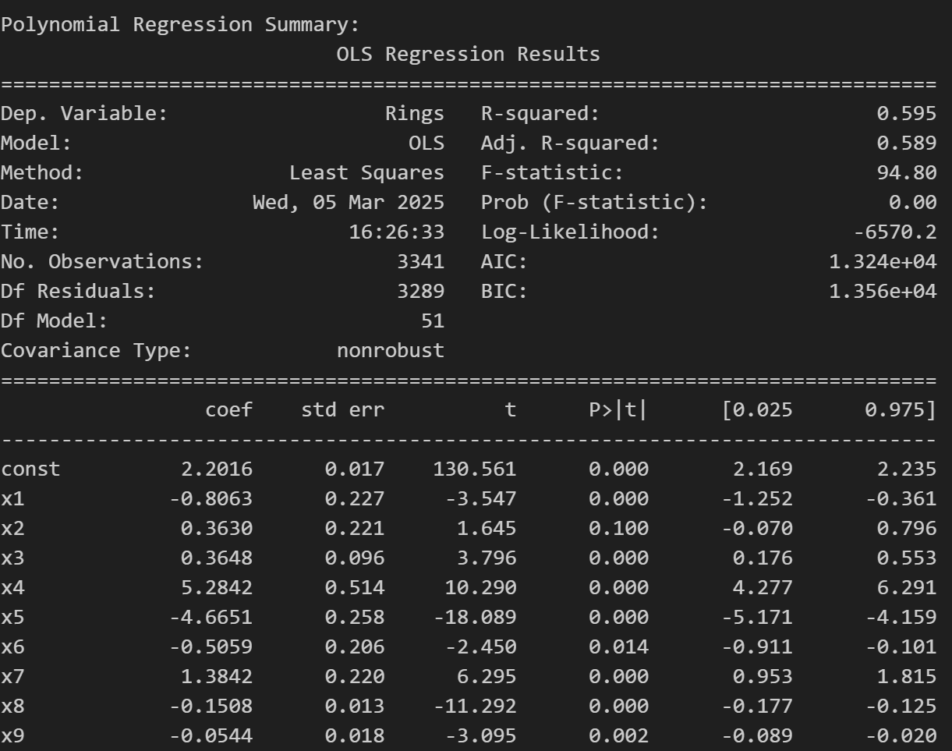
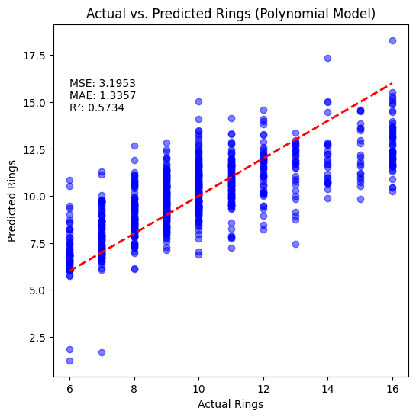
Model Fitting and Evaluation - Polynomial
Figure 9: Performance of Polynomial Model

Slide 10
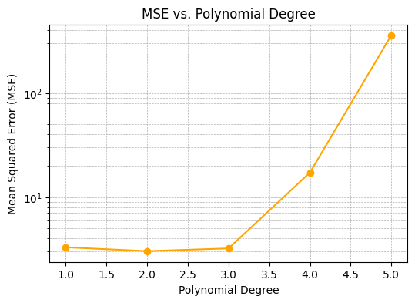
Model Fitting and Evaluation - Polynomial
Polynomial with degree 2 (quadratic) performs better than higher-order polynomials
Figure 10: Evaluation of different polynomial models

Slide 11
Conclusion
Regression Model | R² Score | MSE | MAE
OLS | 0.5811 | 3.2846 | 1.3952
Ridge | 0.5811 | 3.2847 | 1.3953
LASSO | 0.5423 | 3.5886 | 1.4795
Polynomial (Degree 2) | 0.5734 | 3.1953 | 1.3357
Polynomial Regression (Degree 2) provided the most accurate predictions, achieving the lowest MSE and MAE,
suggesting that incorporating non-linearity improves model performance for abalone age prediction.
OLS and Ridge Regression offered similar accuracy and interpretability,
Ridge Regression did not significantly address multicollinearity, as its performance remained nearly identical to OLS.
LASSO Regression was the least accurate in predictions
Indicates a trade-off between model simplicity and predictive performance.

Slide 12


